Slide 1
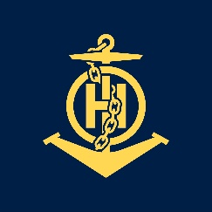
THE PRODUCTION OF NAUTICAL CHARTS IN MOZAMBIQUE
IHO – NIPPON FOUNDATION
ALUMNI SEMINAR
Carlota A. F. de Vasconcelos

Slide 2
Self introduction
IHO – NIPPON FOUNDATION
ALUMNI SEMINAR
Name | Carlota A. F. de Vasconcelos
Alumni year | 2012
Country | Mozambique
Organization | Instituto Nacional de Hidrografia e Navegação
Position/Job title | Cartographer
Current job description | Nautical chart production
!

Slide 3
My career path and projects / Achievements
IHO – NIPPON FOUNDATION
ALUMNI SEMINAR
Working for Hydrograph Office of Mozambique (INAHINA) since 1986 as Cartographic Designer.
Attended several training courses in Traditional Cartography and Maritime Safety Information;
In 2008 attended the first training course in digital cartography using CARIS GIS 4.4 software;

Slide 4
IHO – NIPPON FOUNDATION
ALUMNI SEMINAR
Lessons learned from CHART Course
After the CAT B training course in UKHO Taunton in 2012 I returned back to my country, to work at Hydrographic Office of Mozambique (INAHINA), Department of Cartography, as Marine Cartographer.
Since then, I produced two (2) Habours and one (1) Approaches Paper Charts and I have also participated in production of several charts;

Slide 5
Lessons learned from CHART Course
IHO – NIPPON FOUNDATION
ALUMNI SEMINAR
Confident in cartographic production particularly in sounding selection and quality control of nautical charts.
Leading the production of nautical charts from data processing, compilation and quality control using CARIS GIS software;
Consulting always the OHI publication (S4, INT1 and INT2, etc.);

Slide 6
IHO – NIPPON FOUNDATION
ALUMNI SEMINAR
Lessons learned from CHART Course
Mozambique has updated the official catalogue of nautical charts in 2018. So far, several nautical charts have been published, especially the approaches and habours charts. However, I have participated on production of the following nautical charts:
Porto da Beira ,2014
Porto de Nacala,2014
Aproximação ao Porto da Beira 2014
Aproximação de Quelimane,2017
Aproximação ao Porto de Nacala 2019

Slide 7
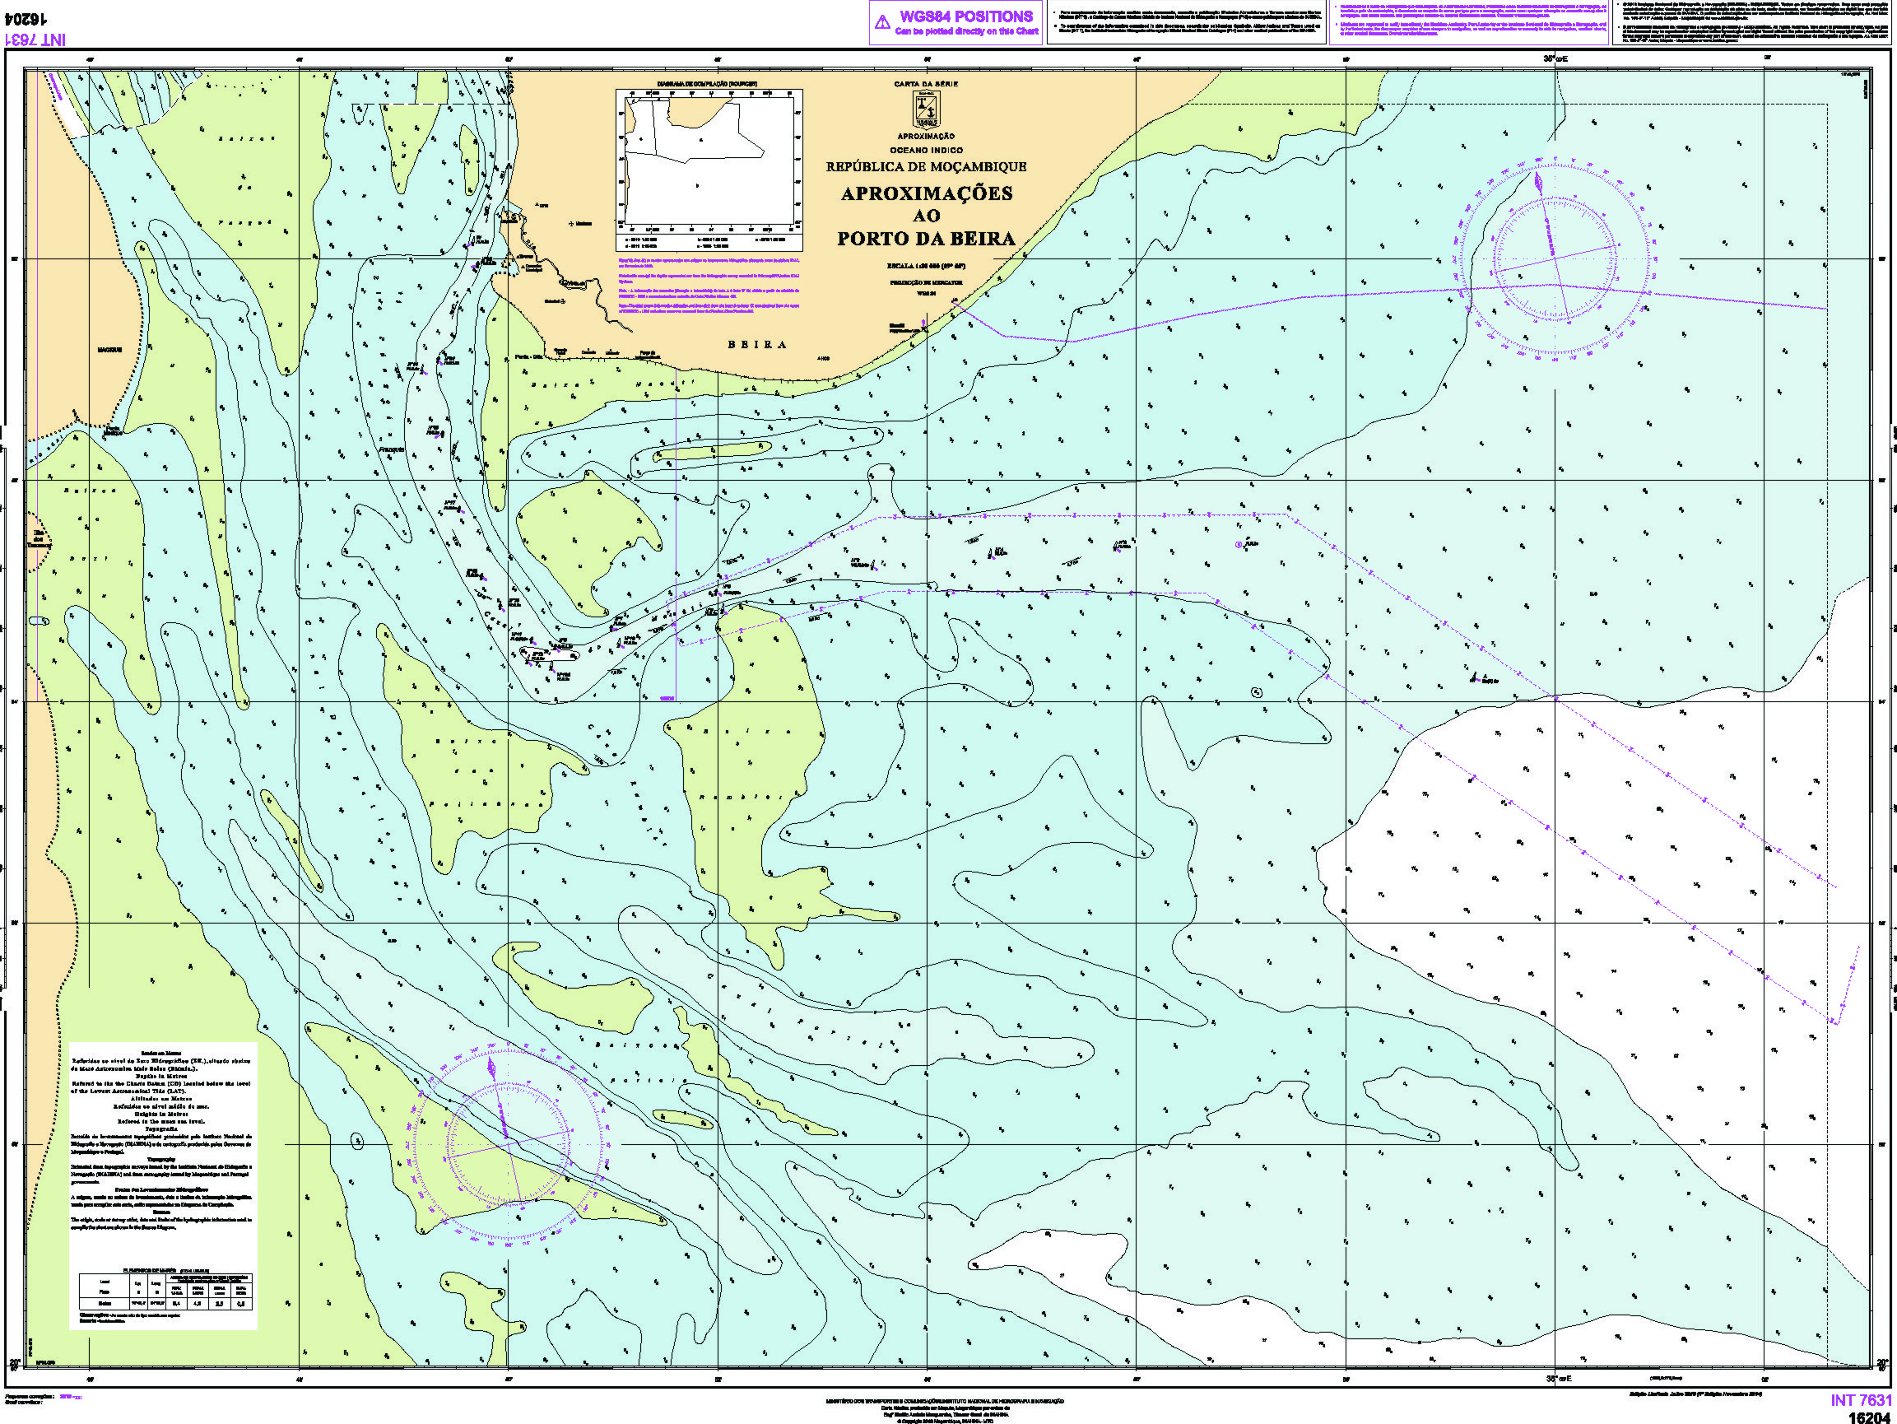
IHO – NIPPON FOUNDATION
ALUMNI SEMINAR
Lessons learned from CHART Course
The more recent Nautical Charts I produced in 2019

Slide 8
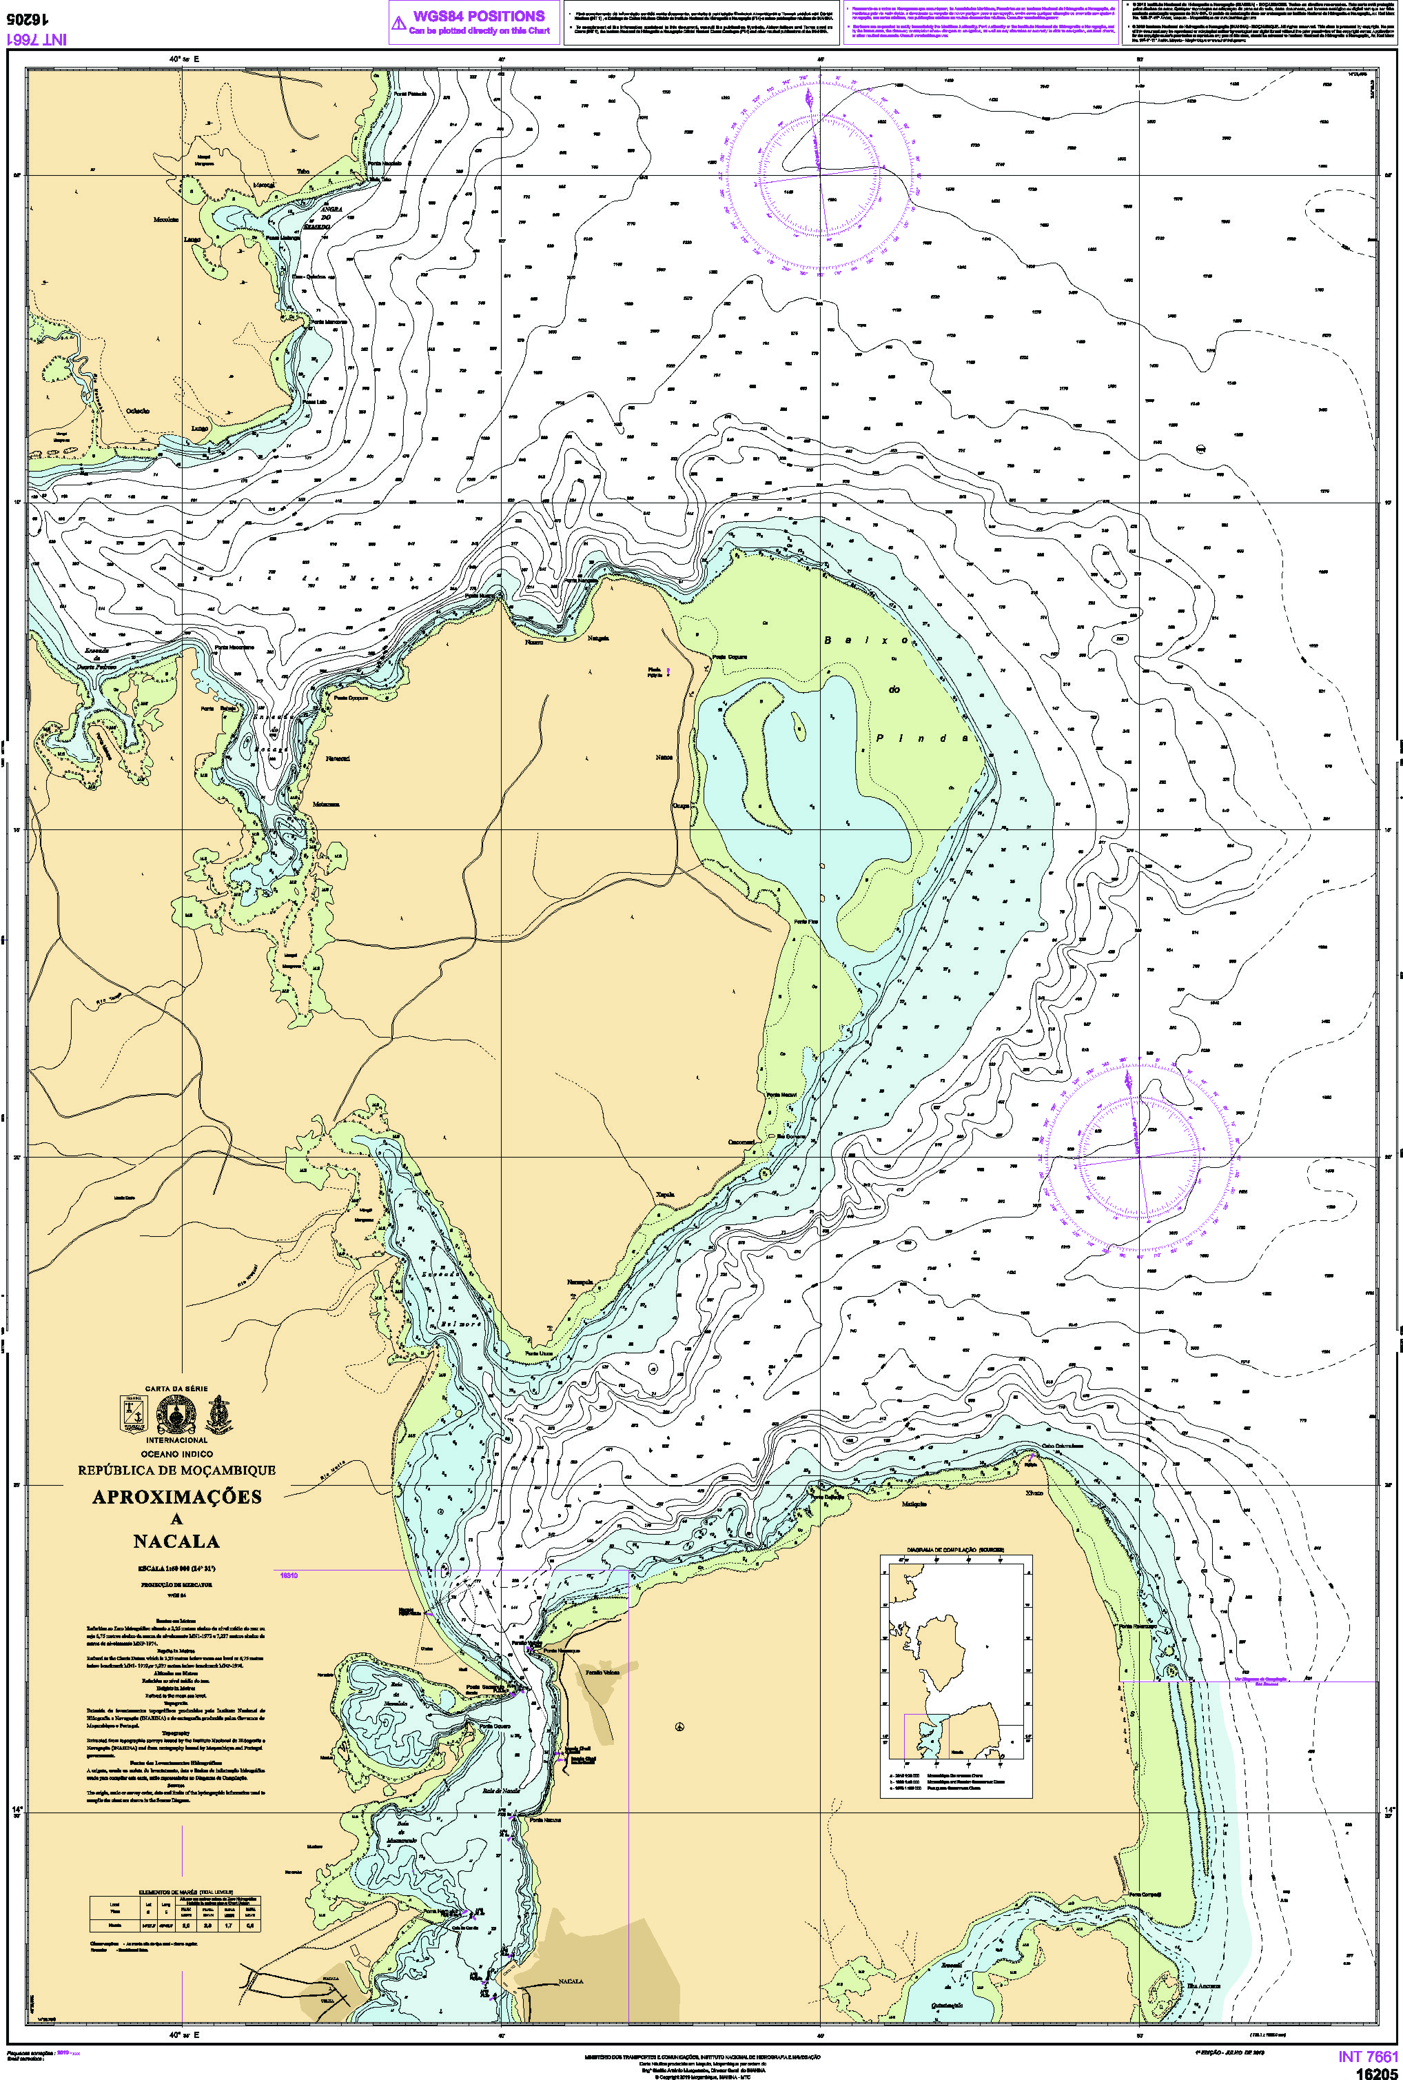
The more recent Nautical Charts I produced in 2019
Future plan is to produce and publishing my first ENC before I retire;

Slide 9
Suggestion for the future
IHO – NIPPON FOUNDATION
ALUMNI SEMINAR
The Nippon Foundation program should introduce the training programme for Category "A“.
Also should introduce the online training programme for Category “B“ to enable many marine cartographers and hydrographers can be trained.

Slide 10
Acknowledgement
At last, I would like to acknowledge Nippon foundation for providing me this opportunity of sharing experience with my fellows and hearing about the work of other hydrographic offices.

